Slide 1

Advanced Certification in
ML and Cloud

Slide 2


Course : MLC
Lecture On : Course 2 Exam Revision
Instructor : Dr. Jyoti Dabass

Slide 3
Agenda
Introduction to Machine Learning
Basics of Machine Learning
Apriori Algorithm
Machine Learning Pipeline
Handling Missing data
Handling outliers
Univariate Analysis
Bi-variate Analysis
RDBMS and SQL
Inferential Statistics (Hypothesis testing, CLT, AB Testing, one and two sample tests)

Slide 4
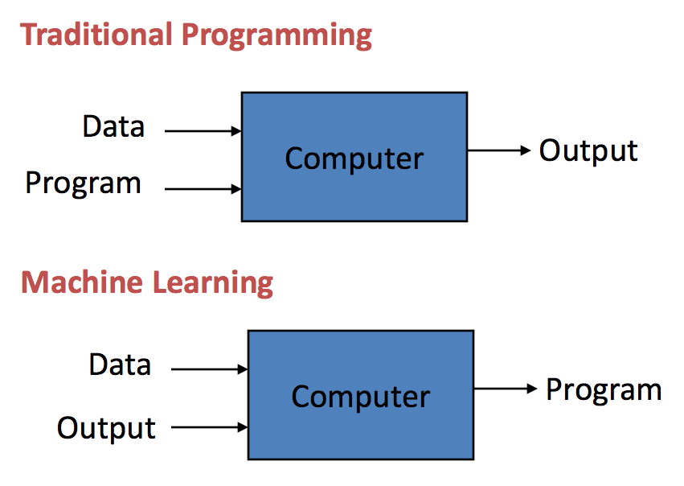
Machine Learning

Slide 5
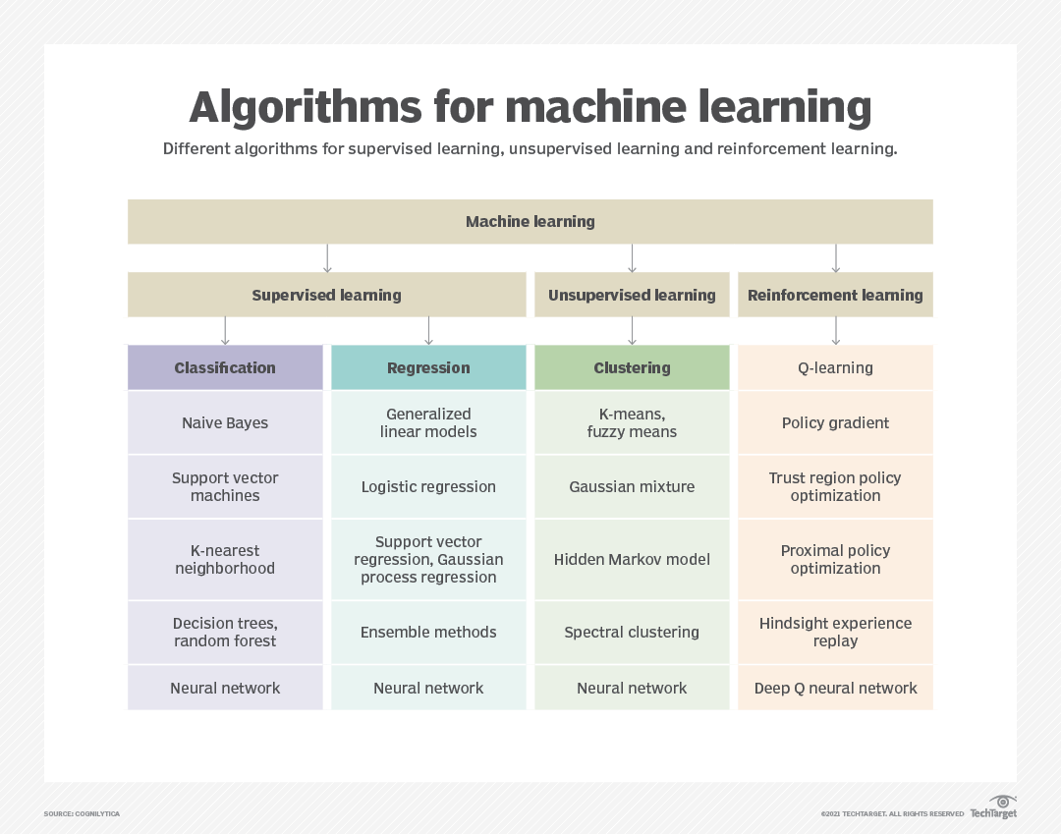
Continued………..

Slide 6
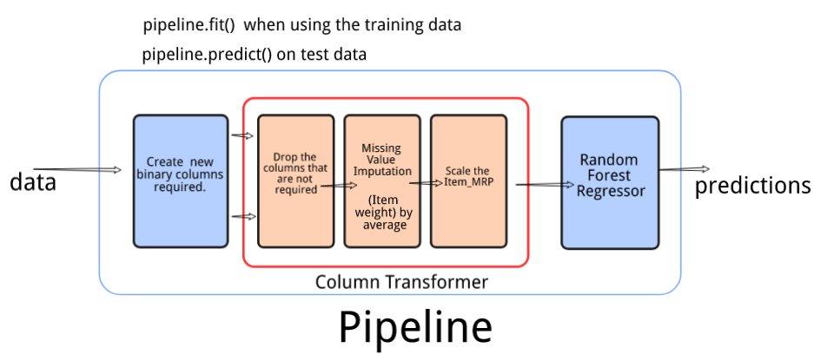
Continued….

Slide 7
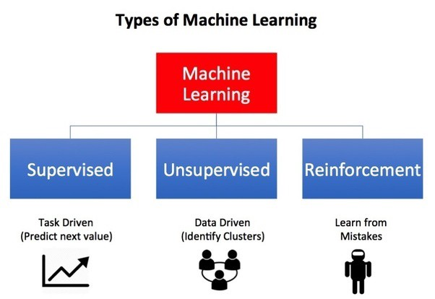
Types of Learning

Slide 8
Applications of Machine Learning
Web search
Computational biology
Finance
E-commerce
Space exploration
Robotics
Information extraction
Social networks
Debugging

Slide 9



Poll
Among the following option identify the one which is not a type of learning? a) Semi-Supervised learning
b) Supervised Learning
c) Unsupervised Learning
d) Reinforcement Learning
Practice in teams of 4 students
Industry expert mentoring to learn better
Get personalised feedback for improvements

Slide 10
Poll Answer
Among the following option identify the one which is not a type of learning? a) Semi-Supervised learning
b) Supervised Learning
c) Unsupervised Learning
d) Reinforcement Learning
Practice in teams of 4 students
Industry expert mentoring to learn better
Get personalised feedback for improvements

Slide 11
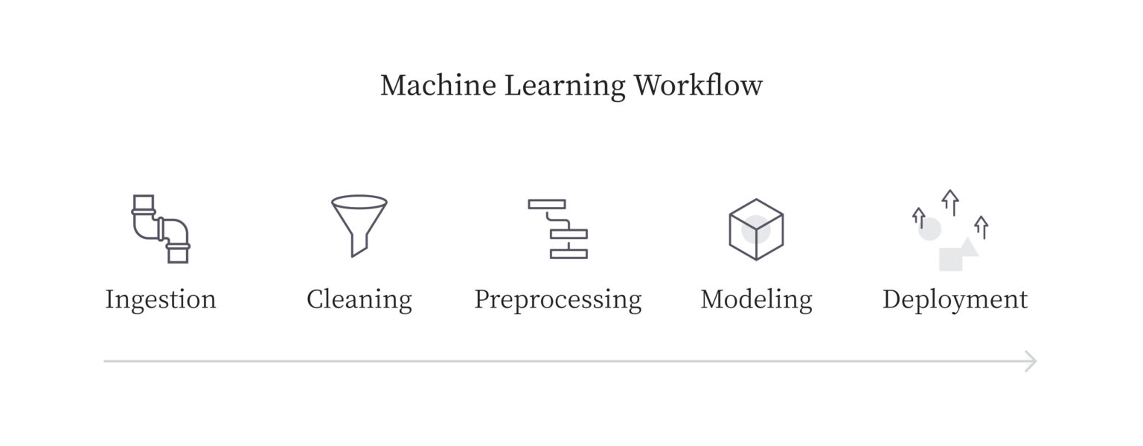
Machine Learning Pipeline

Slide 12
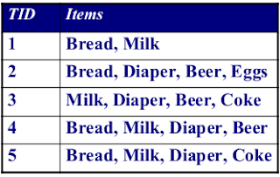
Apriori Algorithm
Association Rules
Support
Confidence
Lift

Slide 13
Continued….
Benefits of Machine Learning Pipeline
Flexibility
Extensibility
Scalability
Why ML Pipeline Matters?
Timely Analysis And Assessment
Real-Time Predictions
Transforming Industries

Slide 14
Machine Learning Pipeline Steps
Data Preprocessing
Data Cleaning
Feature Engineering
Model Selection
Prediction Generation

Slide 15
Handling Missing Data
Removing Data
List wise deletion
Dropping variable
Data Imputation
Encoding missing variables in continuous features.
Encoding missing entry as another level of a categorical variable.
Mean/Median/Mode imputation.
Predictive models for data imputation.
Multiple Imputation.

Slide 16
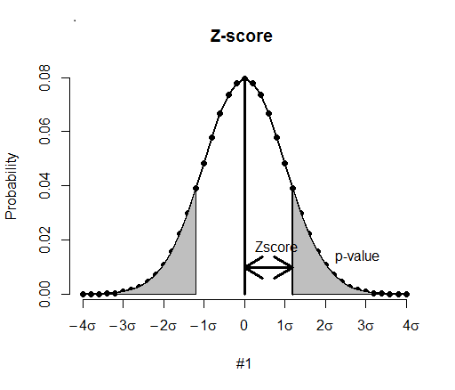
Handling outliers
Boxplot
Scatterplot
Violin plot
Z-Score

Slide 17
Univariate Analysis
Measures of Central Tendency
Mean
Median
Mode
Measures of Dispersion
Range
Variance
Standard Deviation

Slide 18
Types of Univariate Analysis
Frequency distribution table
Bar chart
Histogram
Frequency Polygon
Pie-Chart

Slide 19
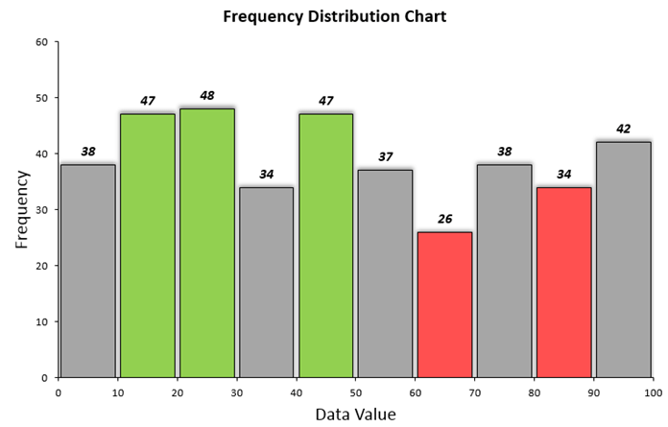
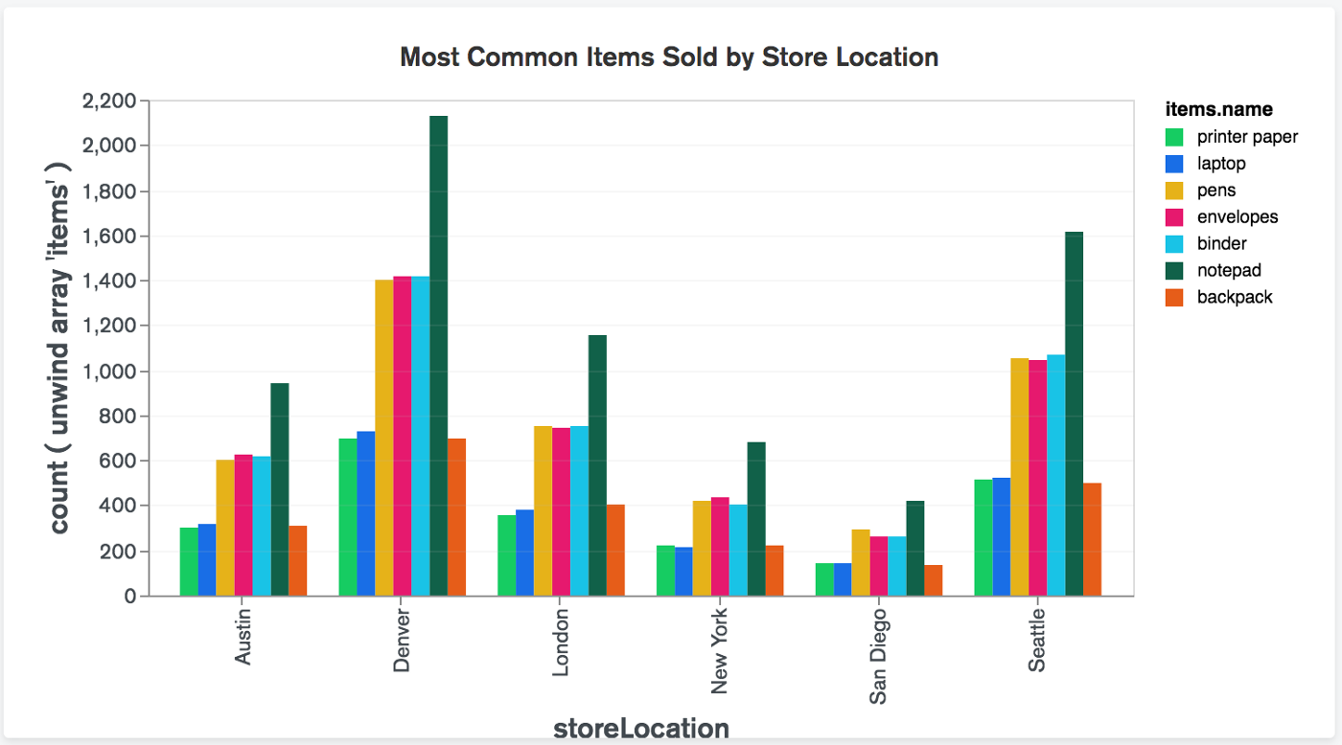
Continued...

Slide 20
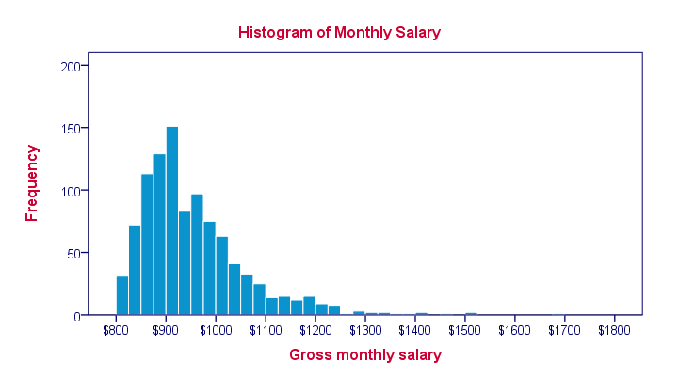
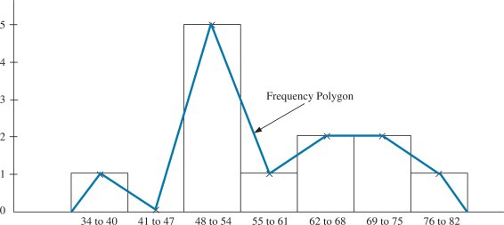
Continued..

Slide 21
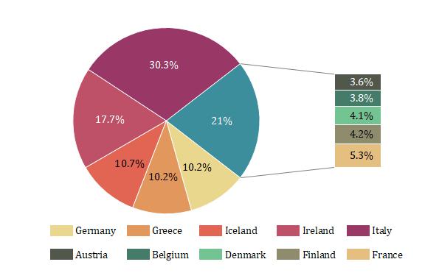
Continued…..

Slide 22
Bivariate Analysis
Scatter plots
Regression Analysis
Correlation Coefficients
Types of bivariate correlations
Numerical and Numerical
Categorical and Categorical
Numerical and Categorical
Bi-variate data examples

Slide 23
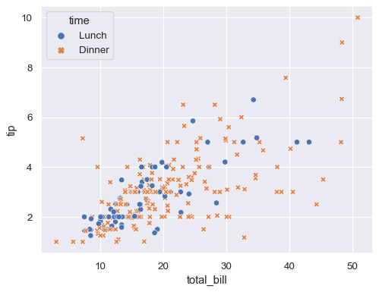
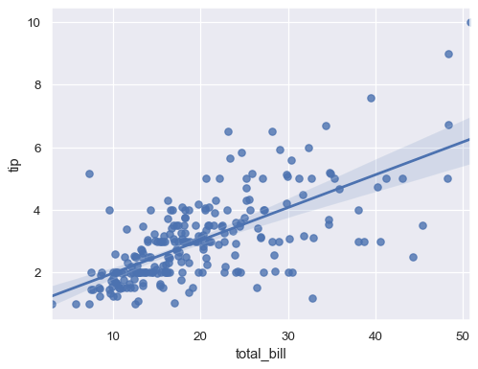
Continued.....

Slide 24
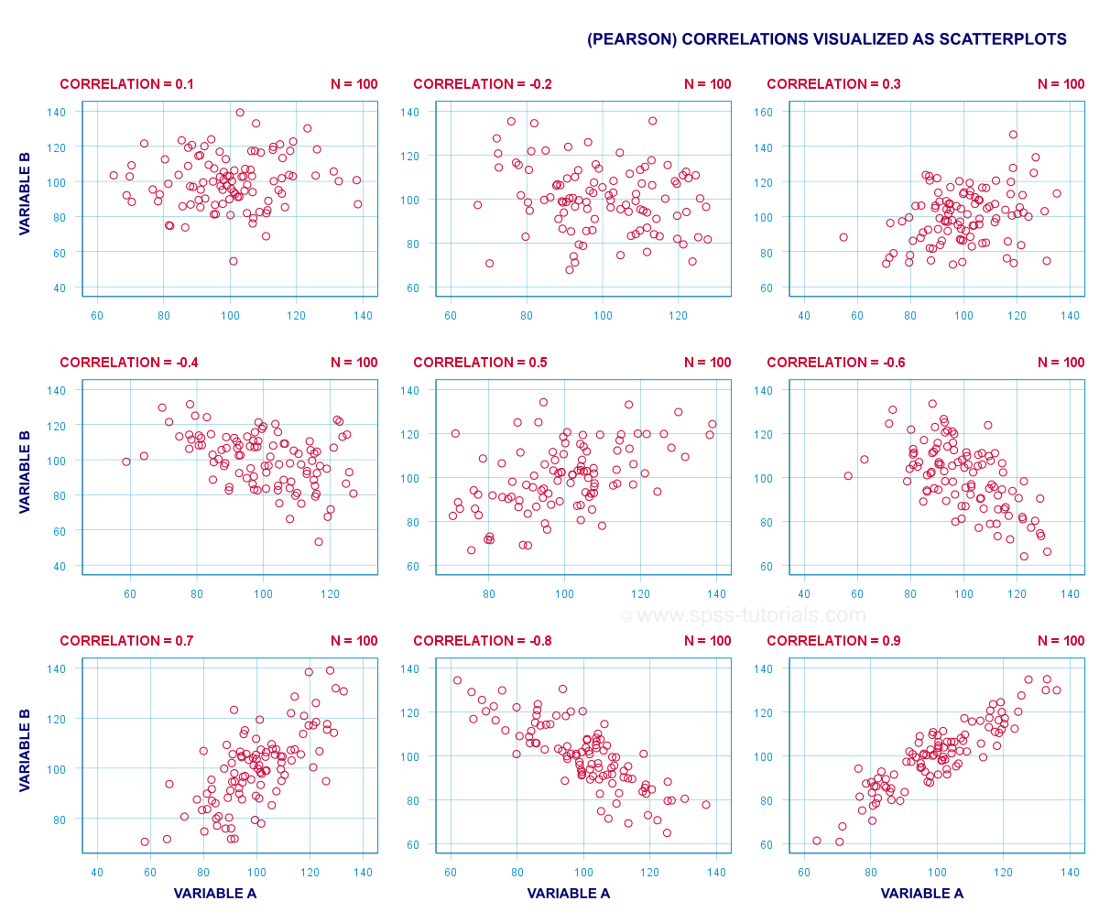
Correlation Coefficient

Slide 25
RDBMS and SQL
RDBMS
Table
Field
Record or a Row
Column
NULL value
SQL Constraints
Data Integrity
Database Normalization
RDBMS Advantages
https://www.mygreatlearning.com/blog/what-is-rdbms/

Slide 26
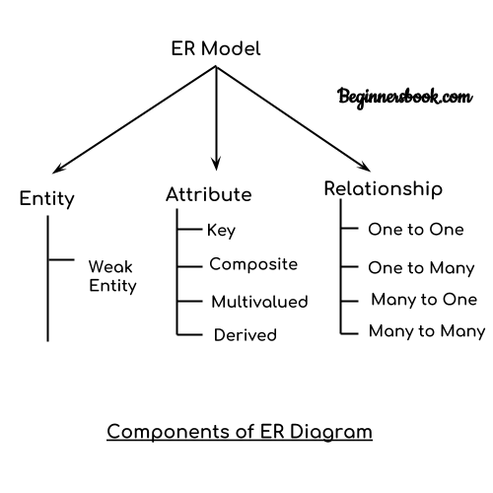
Entity Relationship Diagram
https://beginnersbook.com/2015/04/e-r-model-in-dbms/

Slide 27
Popular Relational Database Management Systems
MySQL
PostgreSQL
Oracle DB
SQL Server
SQLite

Slide 28
Poll
A relational database consists of a collection of
Tables
Fields
C) Records
D) Keys
Practice in teams of 4 students
Industry expert mentoring to learn better
Get personalised feedback for improvements

Slide 29
Poll Answer
A relational database consists of a collection of
Tables
Fields
C) Records
D) Keys
Practice in teams of 4 students
Industry expert mentoring to learn better
Get personalised feedback for improvements

Slide 30
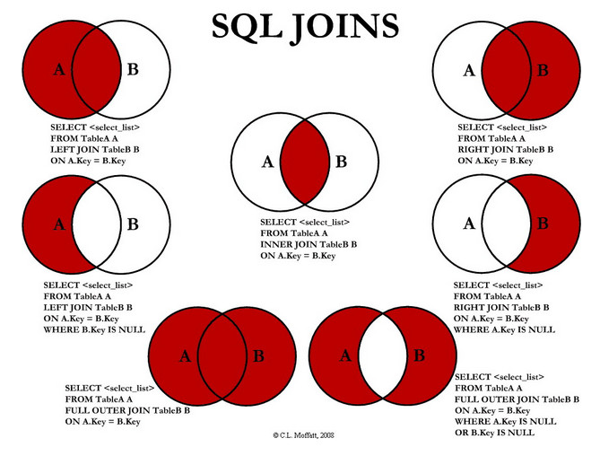
Set of Commands in SQL
SELECT
UPDATE
JOINS
CASE
Nested Sub Queries

Slide 31
Key Takeaway
1
In DBMS, the data is stored as a file, whereas in RDBMS, data is stored in the form of tables
2
SQL is fast and can handle large loads of data.

Slide 32
Inferential Statistics
Central Limit Theorem
Confidence Interval and z-distribution
Statistical Significance
Hypothesis testing
One tailed and two tailed tests
Chi-Square goodness of fit test
F- Statistics (ANOVA)
Multiple-comparison ANOVA problems
Skewness and Kurtosis

Slide 33
Poll
If the assumed hypothesis is tested for rejection considering it to be true is called? a) Null Hypothesis b) Statistical Hypothesis c) Simple Hypothesis d) Composite Hypothesis
Practice in teams of 4 students
Industry expert mentoring to learn better
Get personalised feedback for improvements

Slide 34
Poll Answer
If the assumed hypothesis is tested for rejection considering it to be true is called? a) Null Hypothesis b) Statistical Hypothesis c) Simple Hypothesis d) Composite Hypothesis
Practice in teams of 4 students
Industry expert mentoring to learn better
Get personalised feedback for improvements

Slide 35
Key Takeaway
1
Descriptive statistics summarize the characteristics of a data set. Inferential statistics allow you to test a hypothesis or assess whether your data is generalizable to the broader population.
Apriori is generally considered an unsupervised learning approach, since it's often used to discover or mine for interesting patterns and relationships.
2

Slide 36
References
https://towardsdatascience.com/what-are-the-types-of-machine-learning-e2b9e5d1756f
https://towardsdatascience.com/the-apriori-algorithm-5da3db9aea95
https://medium.com/wids-mysore/handling-missing-values-82ce096c0cef
https://medium.com/@rsehrawat75/univariate-analysis-b938c14ad787
https://poulami98bakshi.medium.com/univariate-and-bivariate-analysis-an-easy-guide-2139dd286d4b
https://medium.com/@eltronicsvilla17/inferential-statistics-132db427f6cb
https://medium.com/@danberdov/dealing-with-missing-data-8b71cd819501
https://medium.com/analytics-vidhya/apriori-algorithm-a1f8589f32a0
https://medium.com/analytics-vidhya/detecting-and-removing-outliers-7b408b279c9
https://algorithmia.com/blog/ml-pipeline
https://www.xenonstack.com/blog/machine-learning-pipeline
https://www.tutorialspoint.com/sql/sql-rdbms-concepts.htm
https://www.codecademy.com/article/what-is-rdbms-sql
https://www.analyticsvidhya.com/blog/2015/03/basics-sql-rdbms/
https://lav-rivendell.medium.com/hypothesis-testing-one-sample-vs-two-sample-t-tests-88d19deb1867
https://medium.com/@ayseninulker/a-beginners-guide-how-an-effective-a-b-test-is-run-a7f121fcfd5
https://medium.com/ml-ai-study-group/confidence-interval-confidence-level-be58d250dd40

Slide 37
#LifeKoKaroLift
Thank You!

